Slide 1
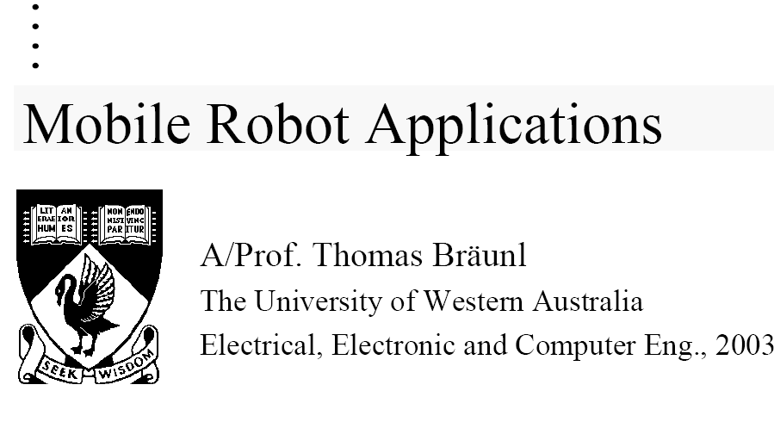

Slide 2
Mobile Robot Applications
Textbook:
  T. Bräunl Embedded Robotics, Springer 2003
Recommended Reading:
1. J. Jones, A. Flynn: Mobile Robots, 2nd Ed., AK Peters, 1999
  → Hobbyist’s introduction, easy reading
2. R. Arkin: Behavior-based Robotics,
  → Overview of behavior-based robotics
3. Kernighan, Ritchie: The C Programming Language
alternatively: <any C programming book>
  → C programming skills are important!

Slide 3
Contents Topics:
Maze driving
  Micro Mouse Contest
Mapping
  Driving in unknown environments
Elementary Image Processing
  Edge detection, color detection, color blobs
Robot Soccer
  autonomous agents

Slide 4
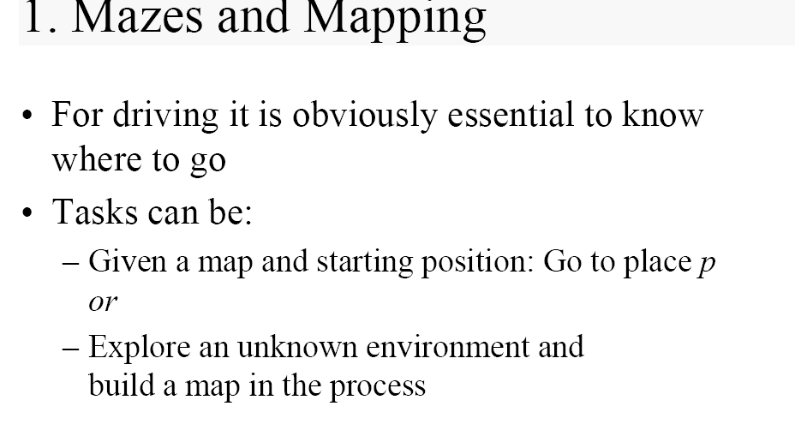
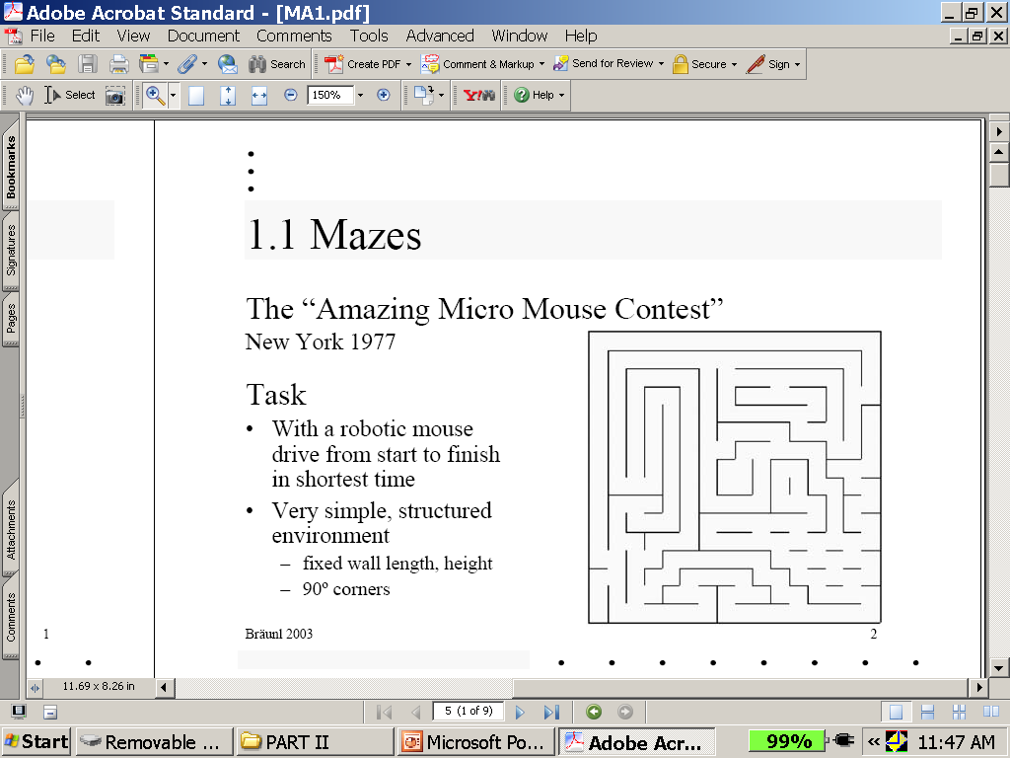
Mazes and Mapping
robot
Know where to go!
Place p
Explore while finding the connection.

Slide 5
More complex Mazes
We won local competition in 1990
Two our teams did not complete the run 2004
This is a tough competitions as participants spend much time and have much experience

Slide 6
Follow the wall algorithm and what is wrong with it

Slide 7
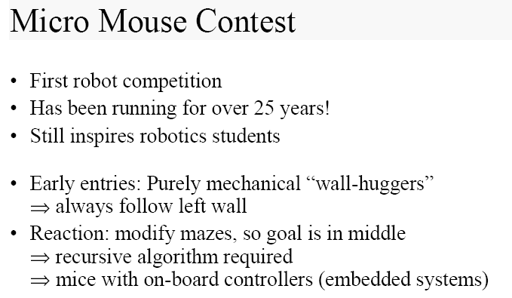
Idea: Always follow left wall.
2. MAZE was MODIFIED, this causes new algorithm needs

Slide 8
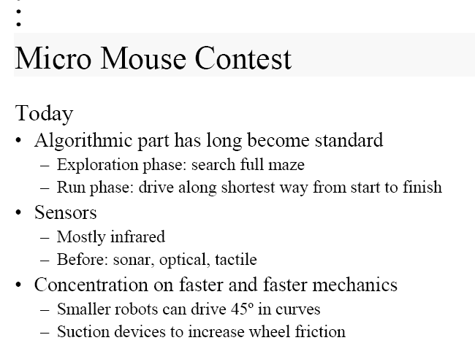
This is becoming a competition for sensors, motors and crazy ideas.
Algorithmic problems are already solved.

Slide 9
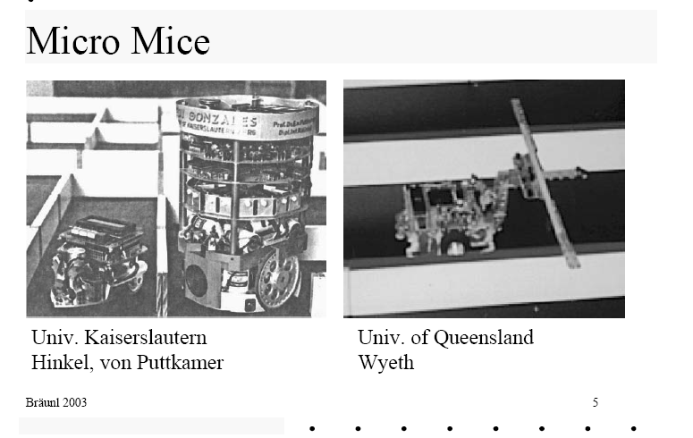
Long rods for sensing

Slide 10
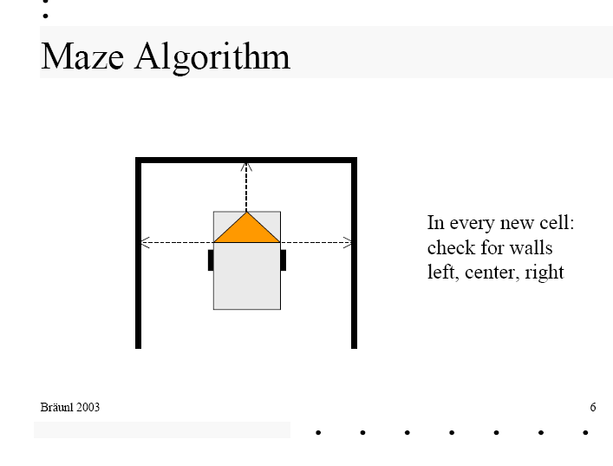
CELL BASED IDEAS
Cell-based maze for mapping and motion planning

Slide 11
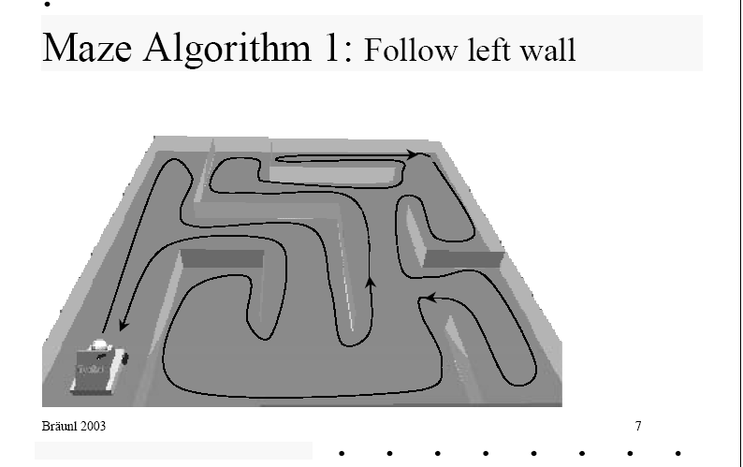
In early contests you can win using this simple algorithm. Next it was changed to make contest more interesting
This algorithm will not find the object in the middle if there is much empty space around.

Slide 12
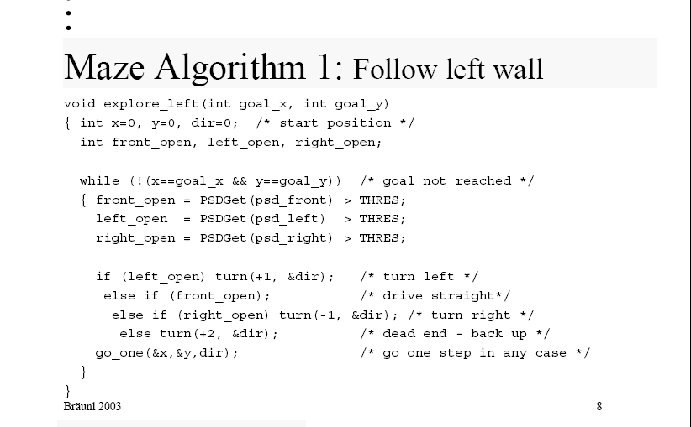
Follow left wall
Algorithm
Psd = position sensor devide
Explore_left: Many Probabilistic variants have been created
x,y = coordinates, dir = direction
flags
PSDGet is from sensors
See next page for these routines
continued

Slide 13
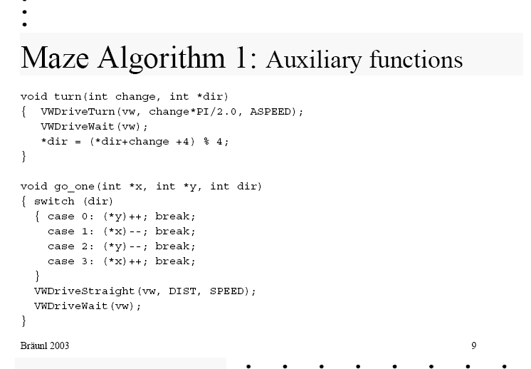
turning
Going one cell
Depending on current direction, update x and y coordinates of the mouse

Slide 14
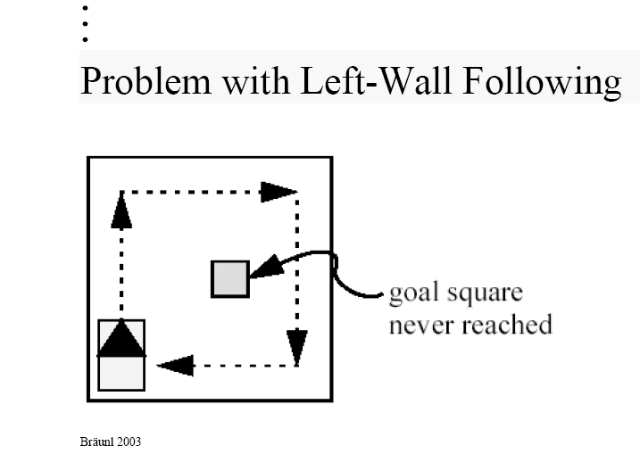
Never finds the gold
Idea to remember: there are good special algorithms for some kinds of mazes.
If you deal with general space or irregular map of labyrinth, you have to use several algorithms and adapt.
There are many recursive algorithms, we will illustrate one of them

Slide 15
Left-wall algorithm versus Recursion

Slide 16
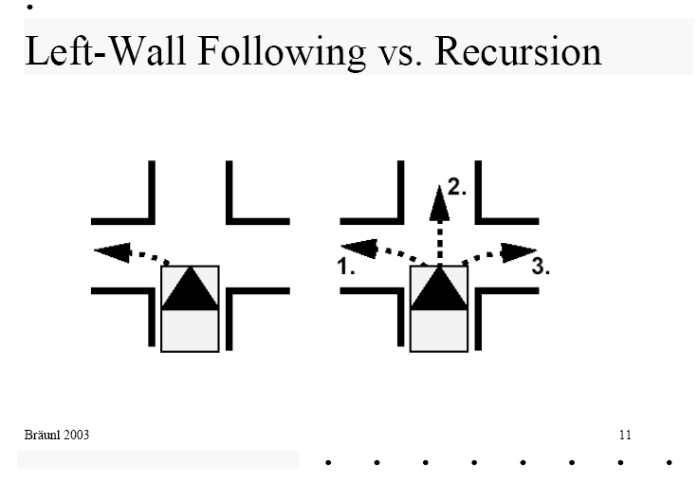
Left wall following
recursion
Check all possibilities and backtrack

Slide 17
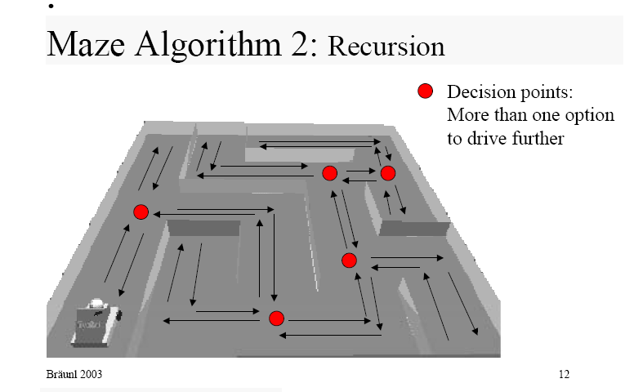
Backtracking!!!
In backtrack point robot knows that it has done a bad decision
This explains and illustrates the concept of backtracking that is fundamental to robotics and AI

Slide 18
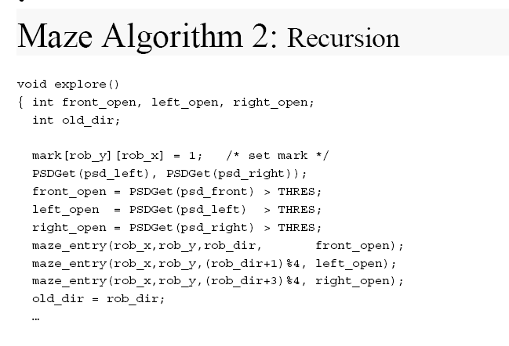
Explore will call itself recursively
Mark x and y position
Check situations if front open etc
Set flags front open etc
Use flags front open etc

Slide 19
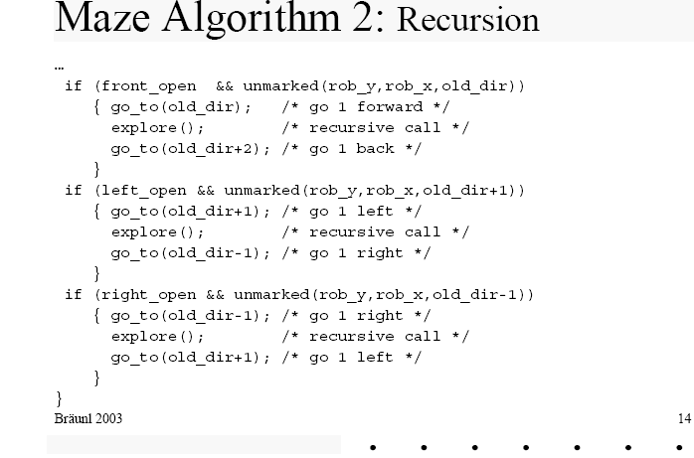
Recursive call of itself
This part shows recursive calls in all situations : Front open, Left open and right open

Slide 20
Idea: combine various maze algorithms

Slide 21
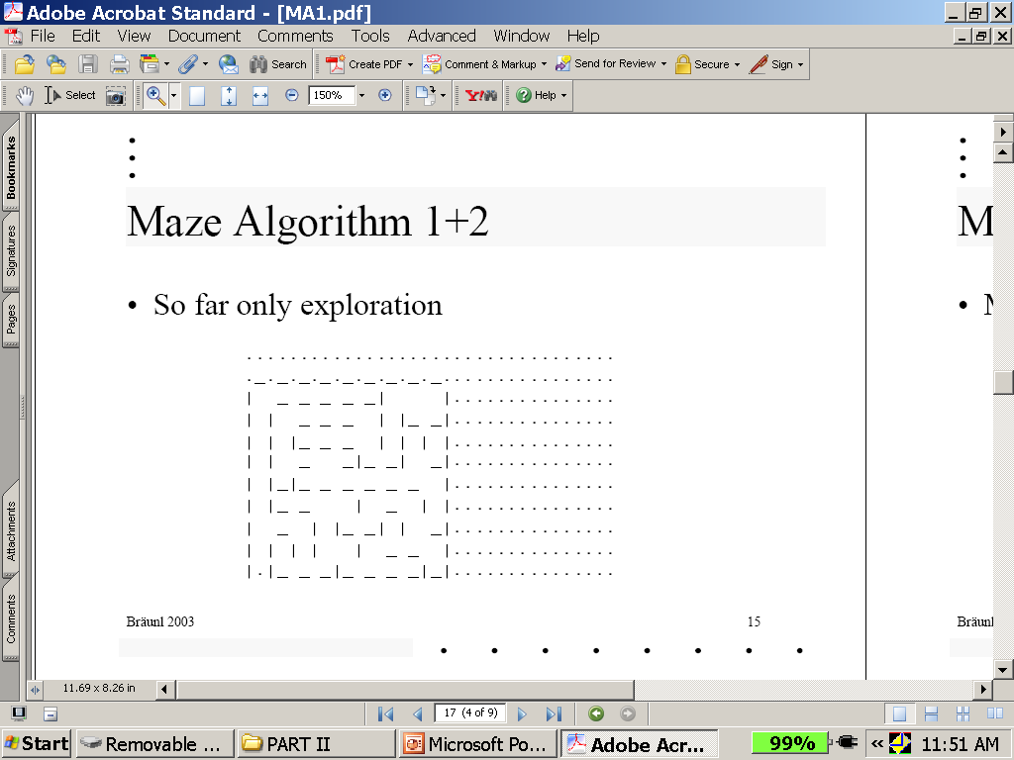
We can combine recursion and left -wall-following algorithms in several ways

Slide 22
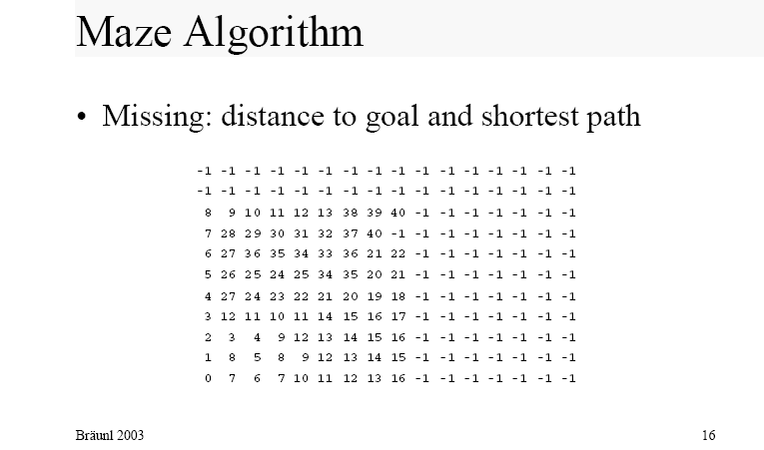
Discuss how it works.
How it is represented.
This map shows calculating distances from the start for labyrinth from bottom left
Using grid we start from here and go everywhere adding 1 at each step
One approach to solve this are the Flood Fill Algorithms

Slide 23
Flood Fill algorithms

Slide 24
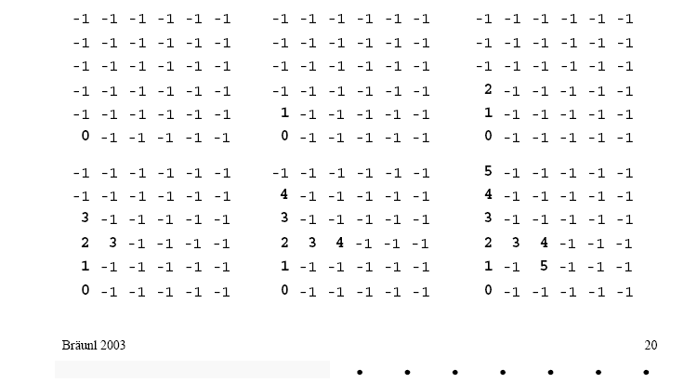
Flood Fill Algorithm Example
Phase 2
Phase 3
Phase 1
This is like the “breadth first search”

Slide 25
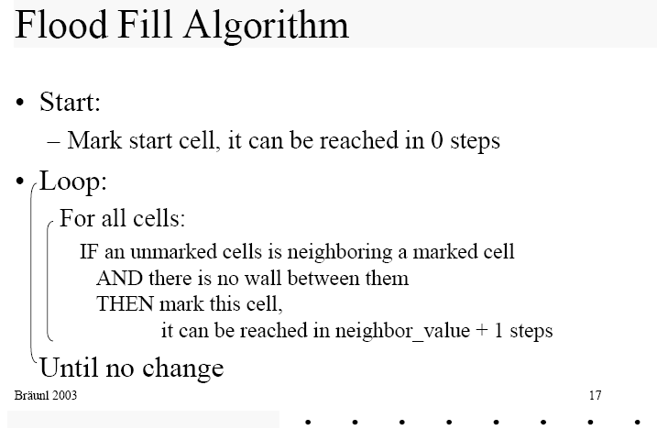
Flood Fill Algorithms
The idea of marking cells appears here again

Slide 26
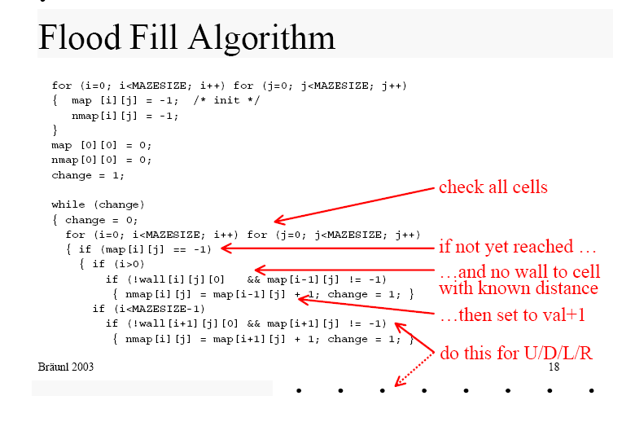
Algorithm continued

Slide 27
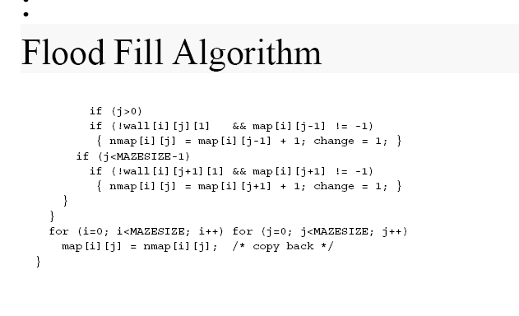
continuation
Example on next slide

Slide 28
Shortest Path
algorithms

Slide 29
Next Stage of Flood Algorithm: Shortest Path
Now we have:
  Explored the maze
  Know the distance to goal from every cell
Missing:
  Shortest path from start to goal
Idea:
  Generate shortest path from goal backward to start

Slide 30
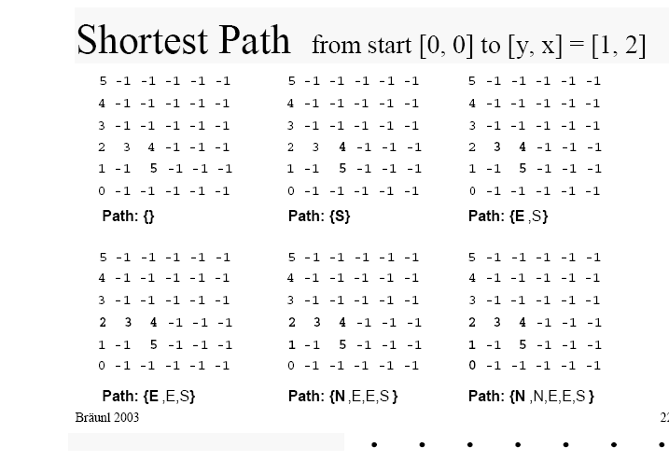
Backtracking to (0,0)

Slide 31
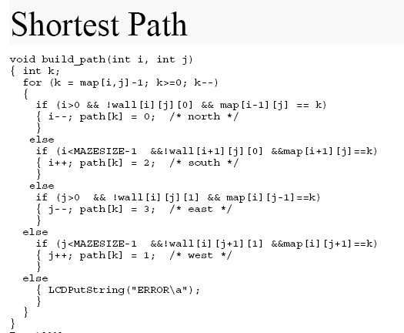
i,j = cooridnates
k= current position
Wall = wall
north
south
east
west

Slide 32
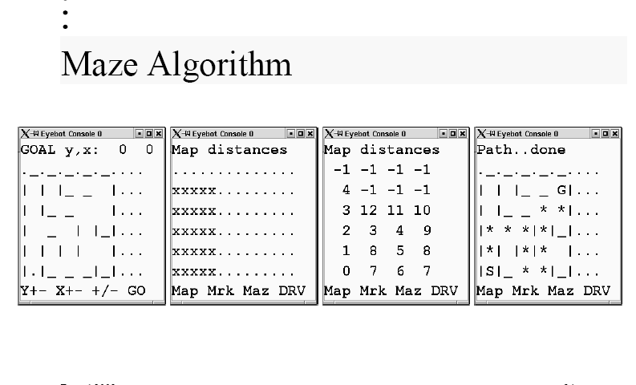
What to visualize in maze algorithms
Visualization is important for the user-programmer to understand what happens.
It really helps!
Map of labyrinth
Part of map that has been covered so far
Distances of cells from start position
Path already done by robot

Slide 33
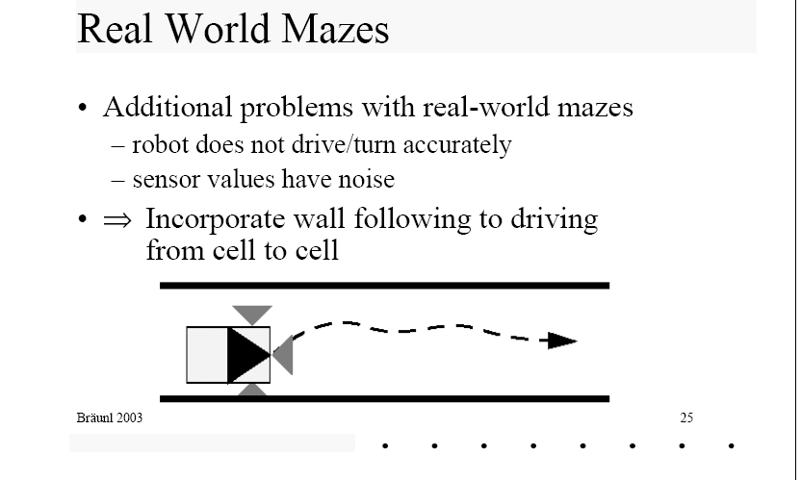
Real-world mazes (hospitals, universities) and labyrinths (forest, park, open battlefield)
Applications in hospitals, museums, mines, big government buildings.
Learn from counting the door or information on walls

Slide 34
Navigation Algorithms
Dijkstra’s Algorithm
A* Algorithm
Potential Field Method
Wandering Standpoint Algorithm
Distbug Algorithm

Slide 35
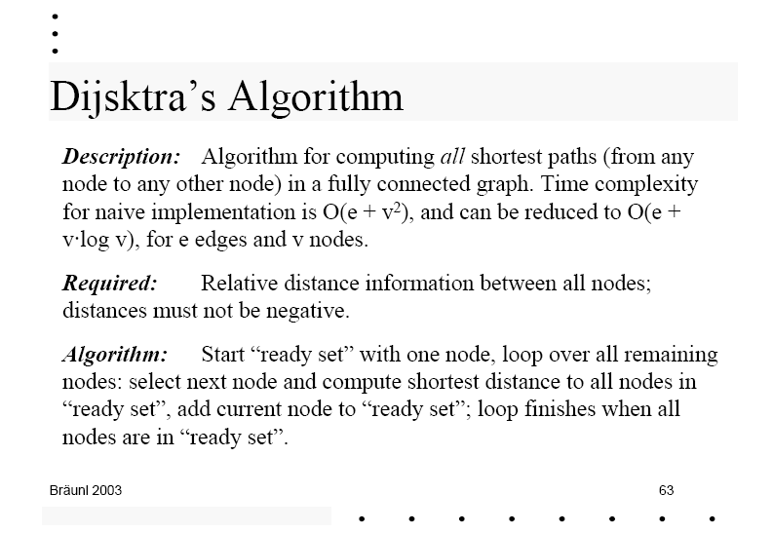
Dijkstra’s Algorithm for all shortest paths

Slide 36
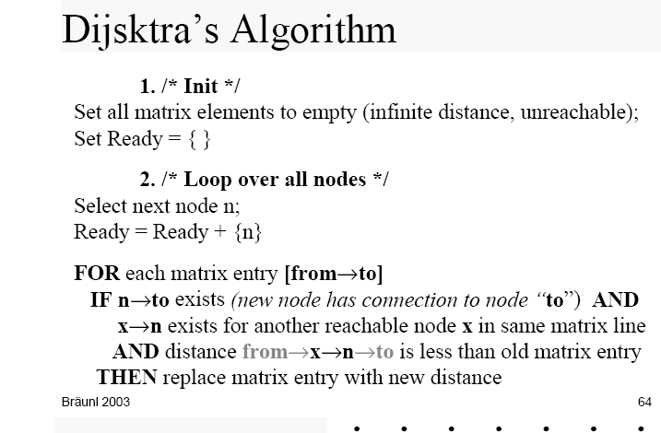

Slide 37
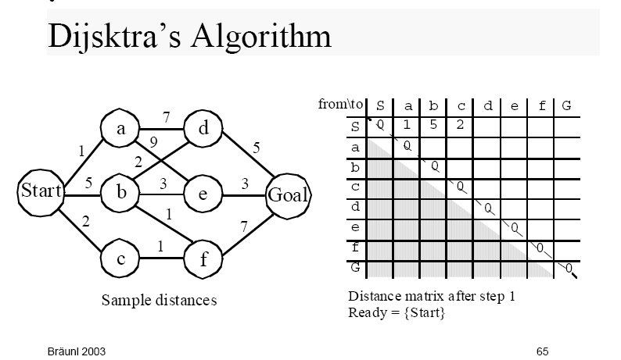

Slide 38
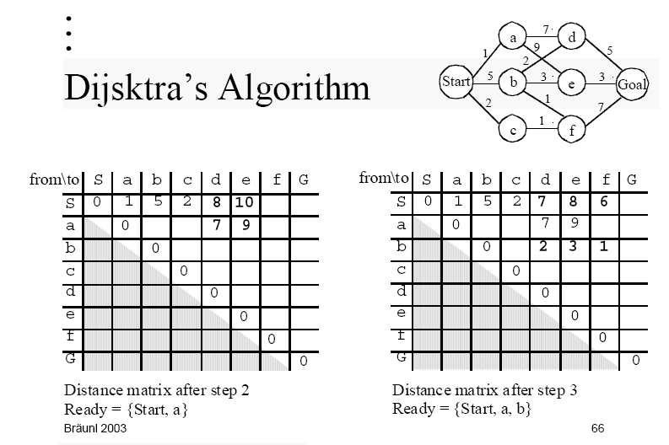

Slide 39
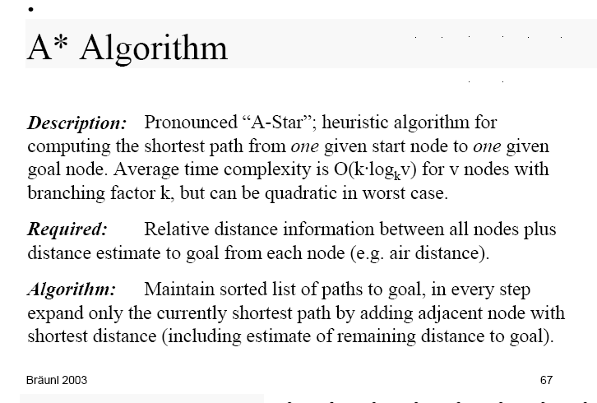
A* Algorithm for shortest path

Slide 40
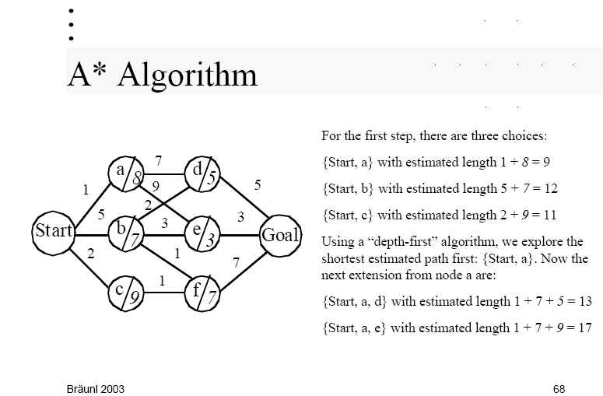
Estimation such as geometric distance

Slide 41
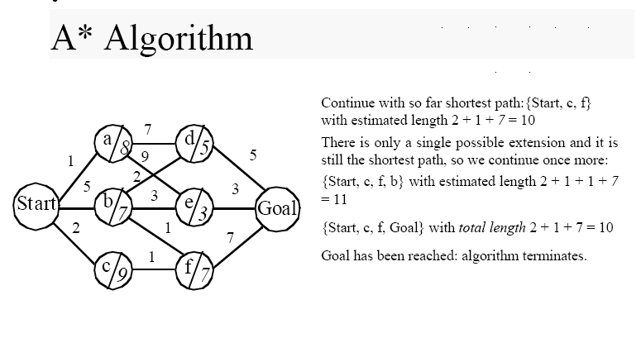
Near the goal estimated distances are real distances, no obstacles

Slide 42
Potential Field Method

Slide 43
Potential Field Method for map creation
Description:
  Global map generation algorithm with virtual forces.
Required:
  Start and goal position, positions of all obstacles and walls.
Algorithm:
  Generate a map with virtual attracting and virtual repelling forces.
  Start point, obstacles, and walls are repelling,
  goal is attracting,
  force strength is linear to global object distance,
  robot simply follows force field.

Slide 44
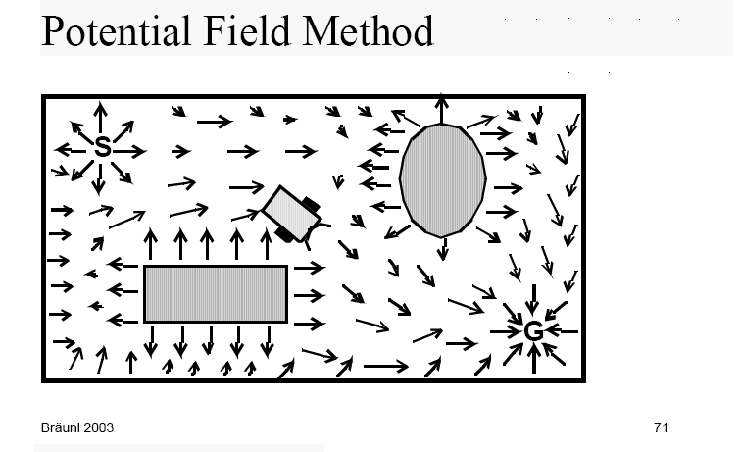

Slide 45
